Slide 1




Consumer Goods Ad Hoc Insights

Slide 2
About
Atliq Hardwares, a prominent Indian computer hardware manufacturer, has established a strong global presence, extending its reach beyond India. As a leader in the industry, Atliq is renowned for its high-quality products and services, catering to customers both domestically and internationally.

Slide 3
Top 3 Products In Divisions With High Total Sold Quantity In The Fiscal Year 2021
Top 5 Customers With Average High Discount
Business In APAC
Products With Highest And Lowest Manufacturing Costs
Segment With Most Increase In Unique Products In 2021 vs 2020
Gross Sales Amount For Atliq Exclusive
Unique Product Increase In 2021 vs. 2020
Channel Gross Sales In The Fiscal Year 2021
Unique Product Counts For Each Segment
Total Sold Quantity In 2020

Slide 4
Unique Product Increase In 2021 vs. 2020
Segment With Most Increase In Unique Products In 2021 vs 2020
Business In APAC
Unique Product Counts For Each Segment
Products With Highest And Lowest Manufacturing Costs
Top 5 Customers With Average High Discount
Total Sold Quantity In 2020
Top 3 Products In Divisions With High Total Sold Quantity In The Fiscal Year 2021
Gross Sales Amount For Atliq Exclusive
Channel Gross Sales In The Fiscal Year 2021

Slide 5
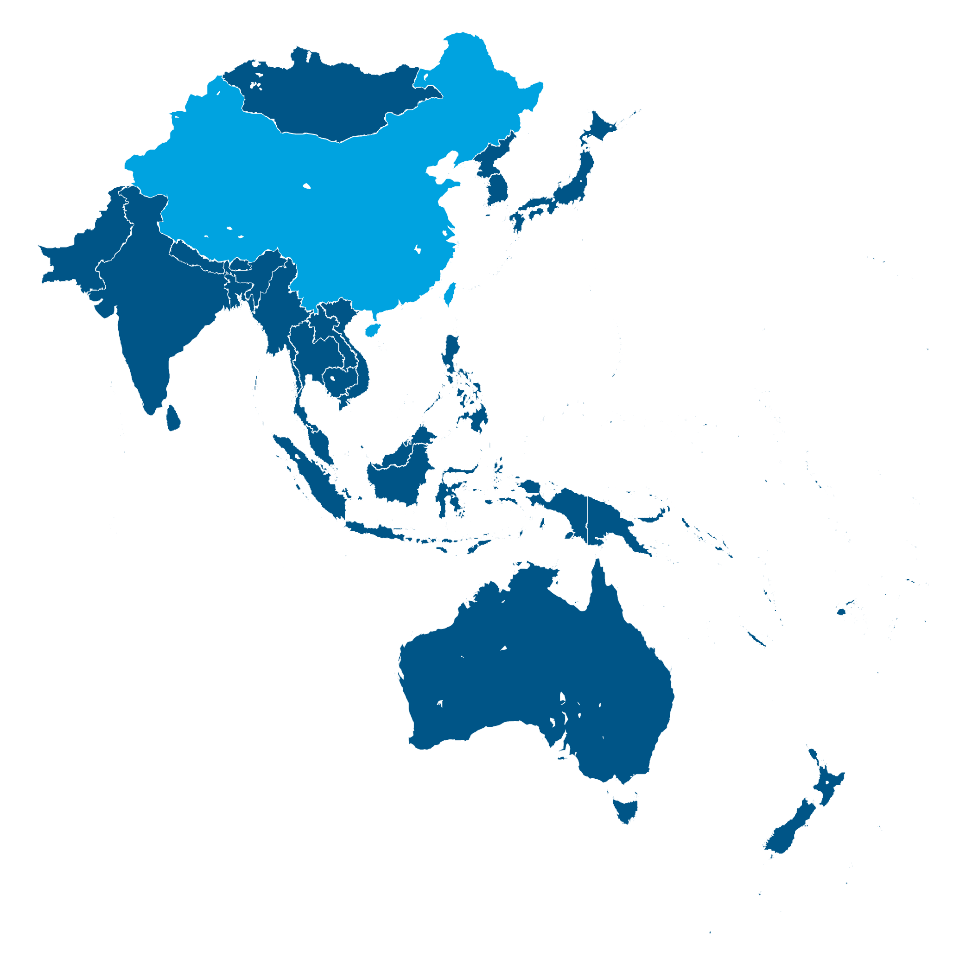
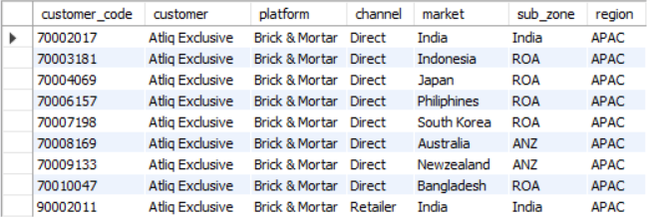
business in the APAC region
The business in APAC region countries are mostly through Direct channel except India which also has a retailer channel.

Slide 6
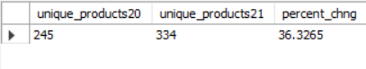
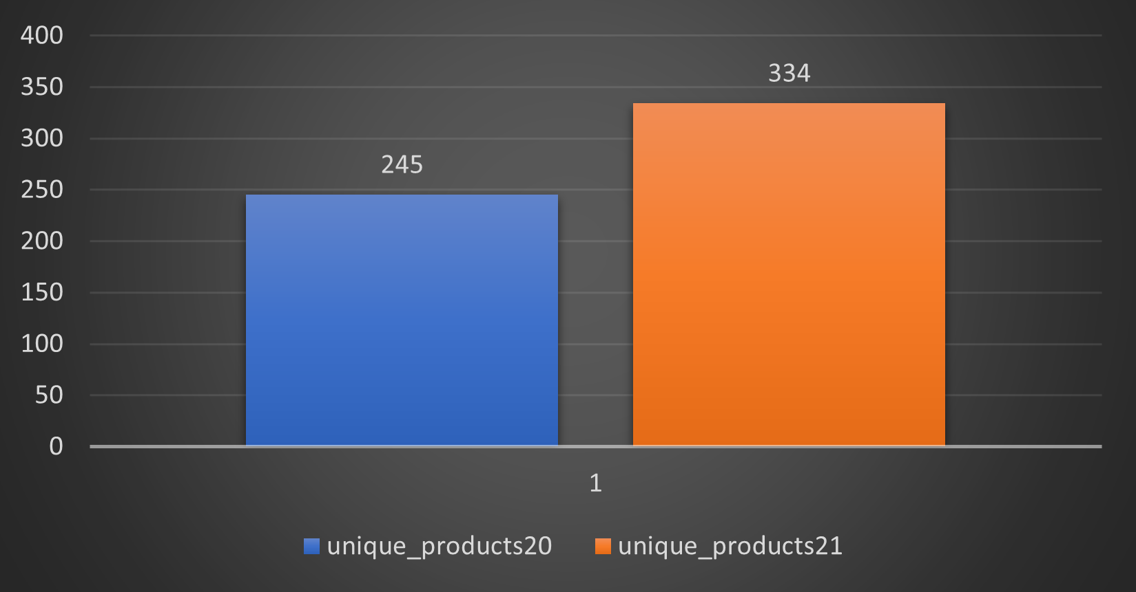
percentage of unique product increase in 2021 vs. 2020
The no. of unique products in 2021 is 36.33% i.e., 89 products more than the previous year 2020.

Slide 7
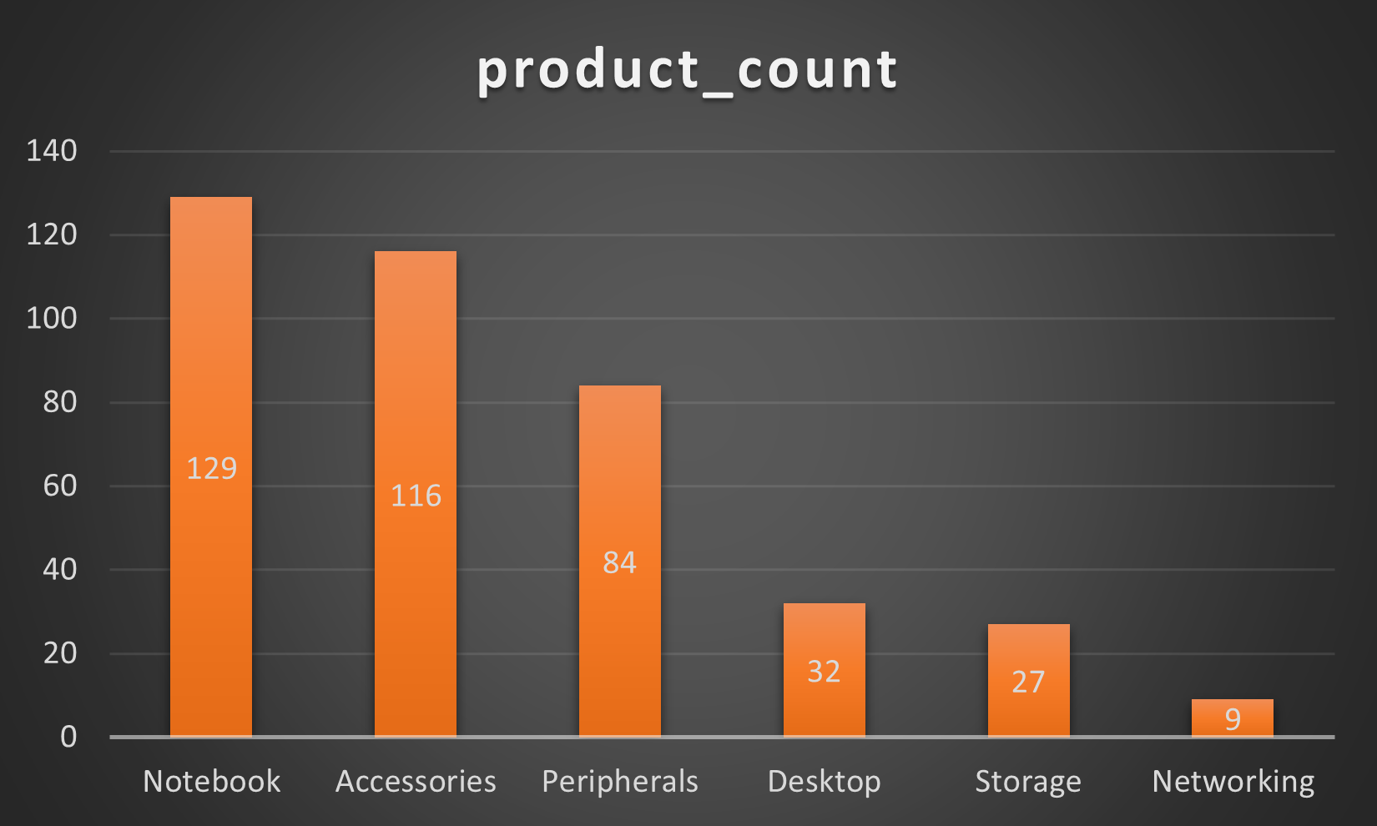
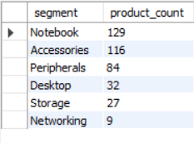
all the unique product counts for each segment
So, what we get is that Notebook has the most unique products, whereas Networking has the least unique products in their respective segments.

Slide 8
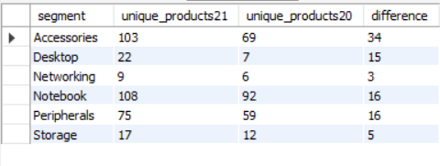
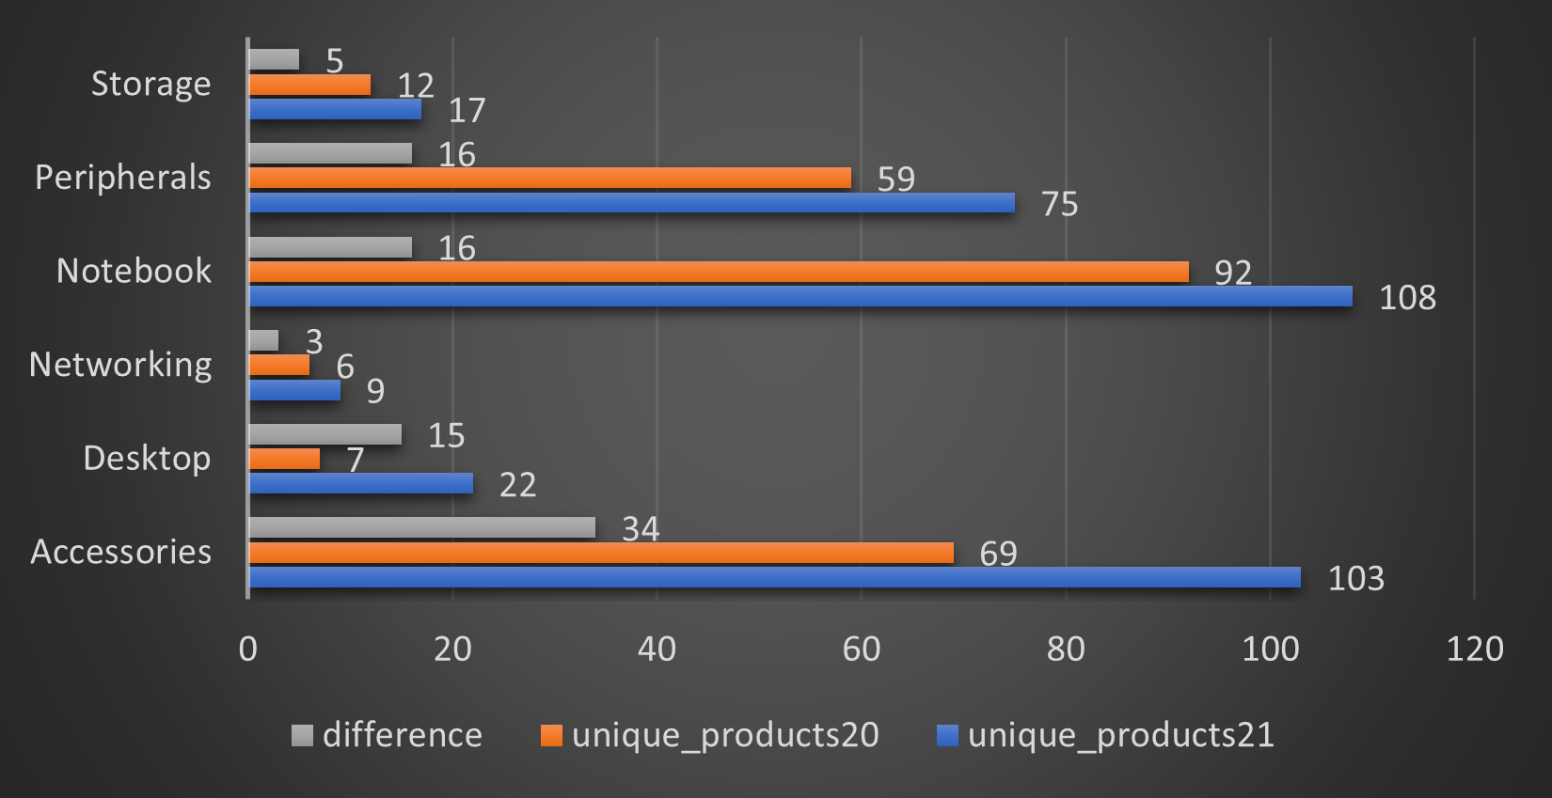
segment with most increase in unique products in 2021 vs 2020
Accessories is the segment that got the most increase in the unique products from year 2020 to 2021.
And Networking is the segment with least increase in unique products.

Slide 9
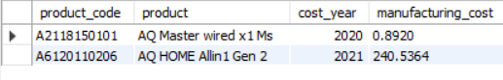
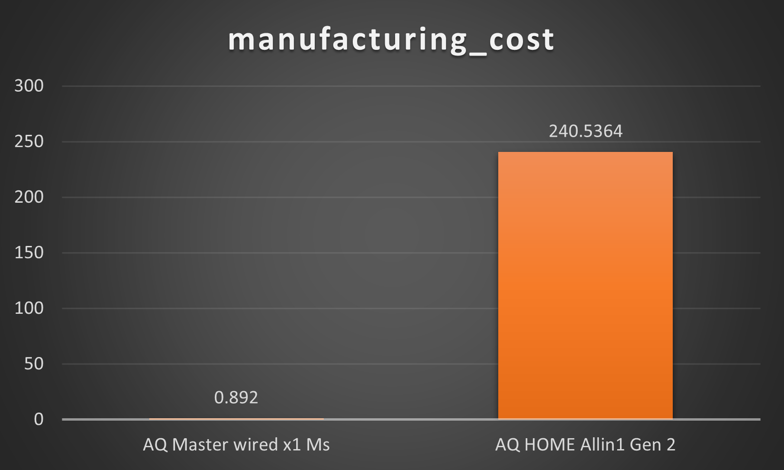
products with highest and lowest manufacturing costs
Here are the most expensive and least expensive products to manufacture with their respective year.

Slide 10
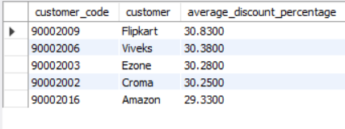
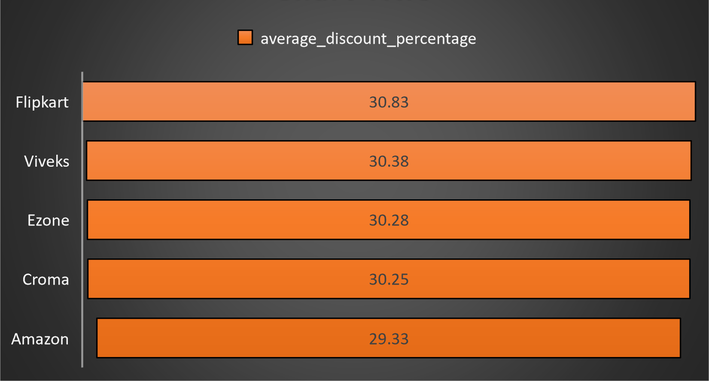
top 5 customers with average high discount
These are the top 5 customers with average high pre-invoice-discount in the market India.

Slide 11
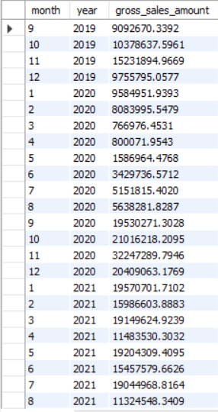
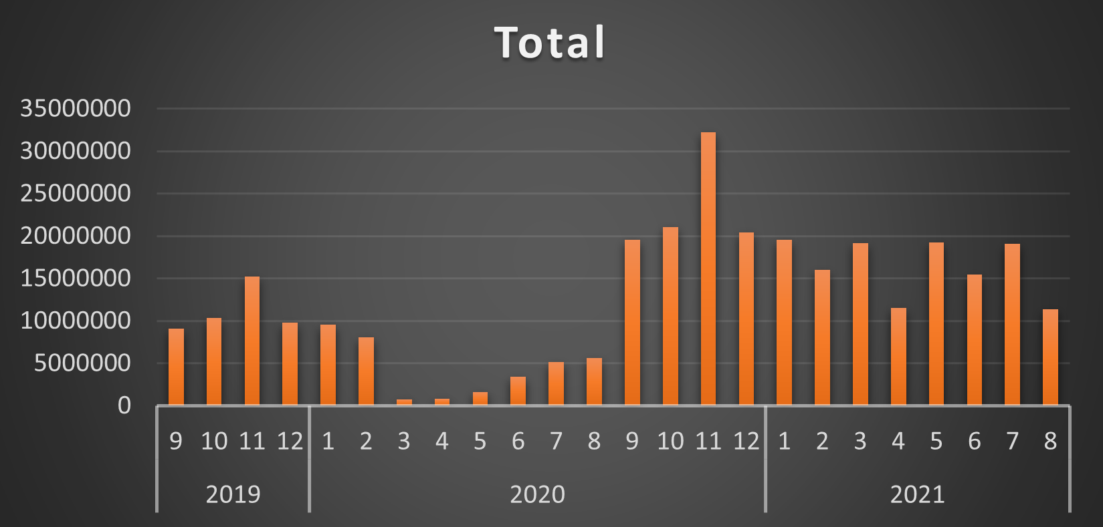
Gross sales amount for Atliq Exclusive
From the chart we see, that month of November had the highest gross sales in a year for the customer AtliQ Exclusive.

Slide 12
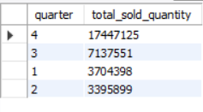
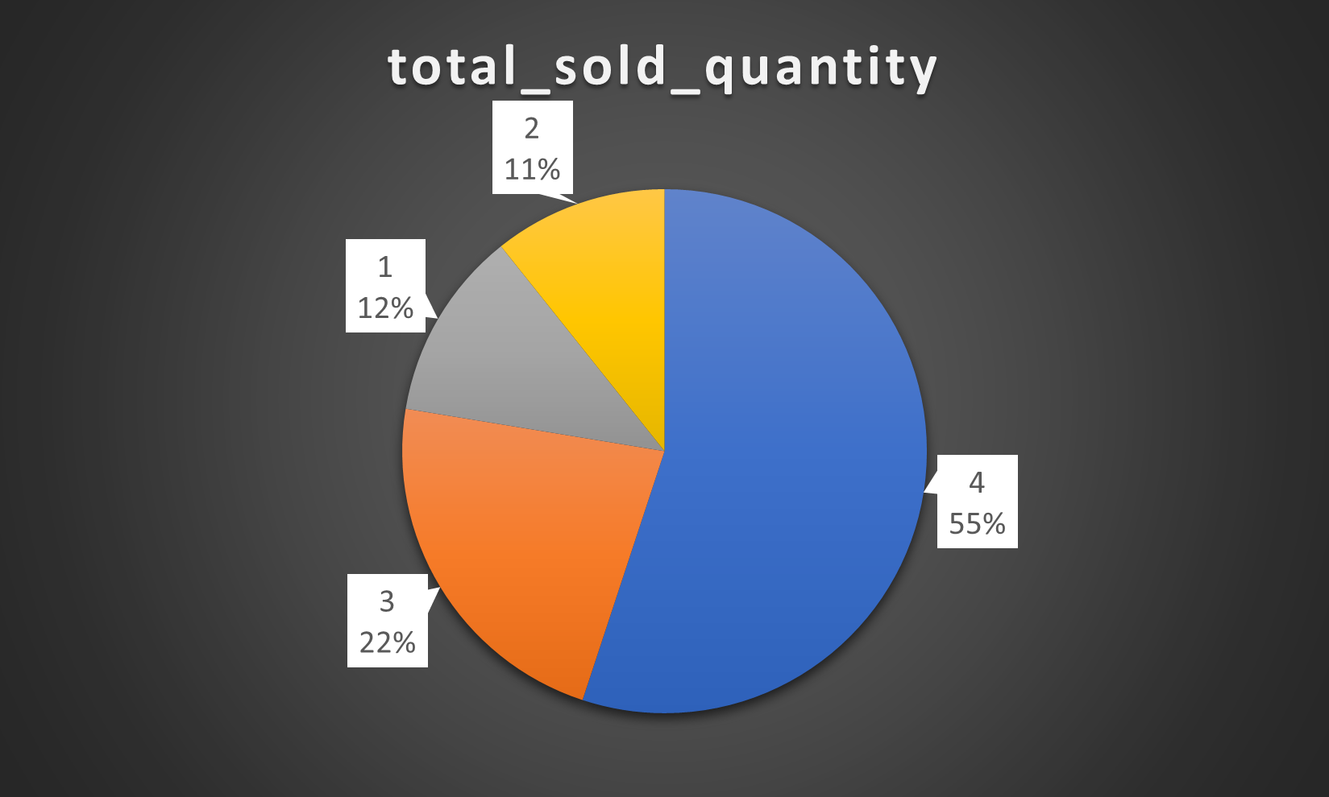
total sold quantity in 2020
The 4th quarter in the year 2020 had the maximum total sold quantity.
And the 2nd quarter had the minimum total sold quantity.

Slide 13
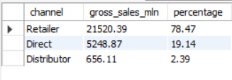
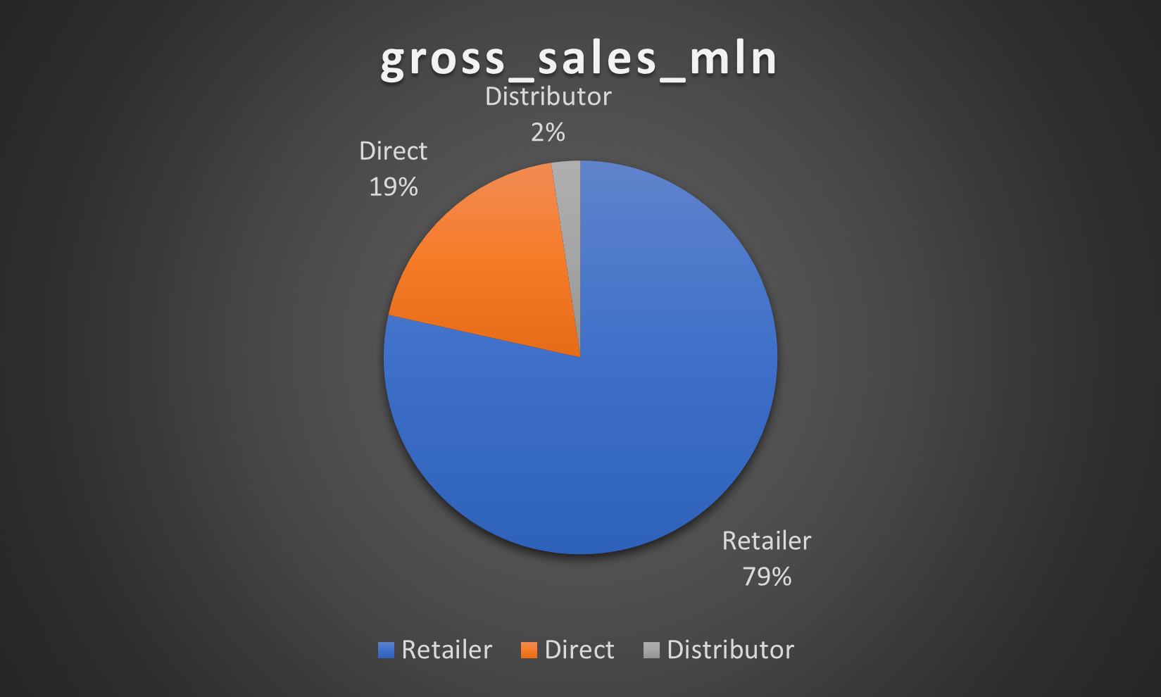
Channel gross sales in the fiscal year 2021
So, the retailer channel had the highest gross sales in the fiscal year 2021, contributing almost 79% to it.

Slide 14
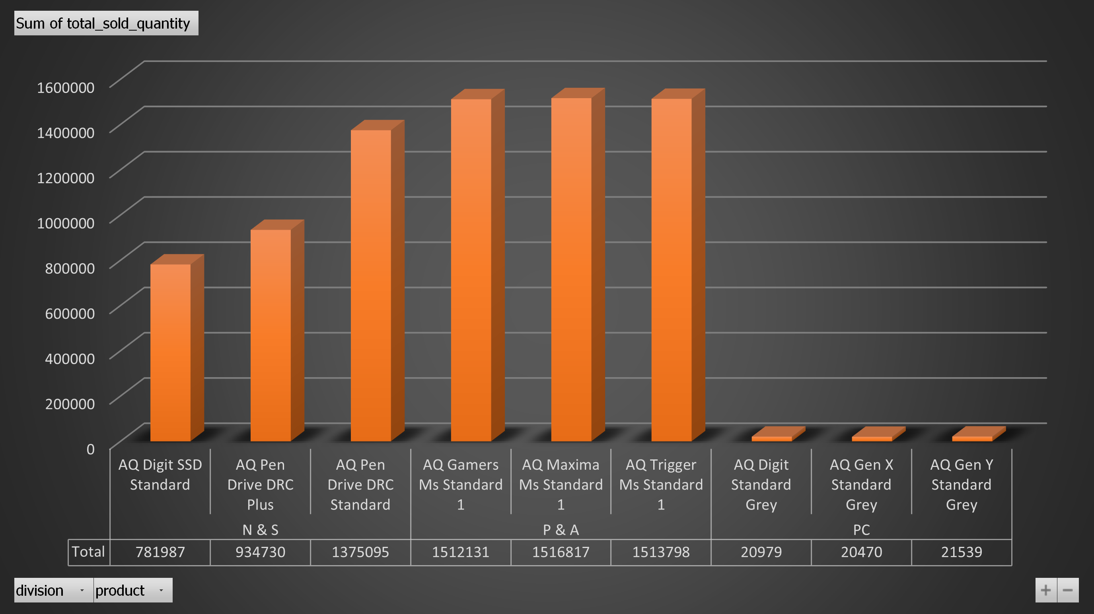
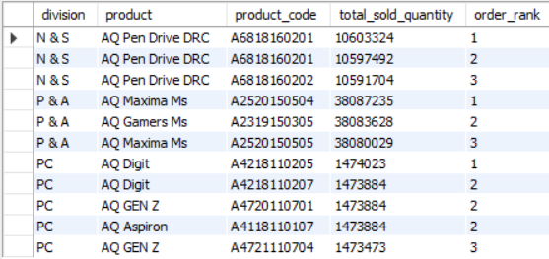
Top 3 products in divisions with high total sold quantity in the fiscal year 2021
Here are top 3 products from each divisions with high total sold quantity for fiscal year 2021.
Some product but different variant had also sold high within a division.

Slide 15
Thank you

